Slide 1

Go Crown – Pune 2025

Slide 2

transformation

Slide 3

Are you ready …

Slide 4




Slide 5

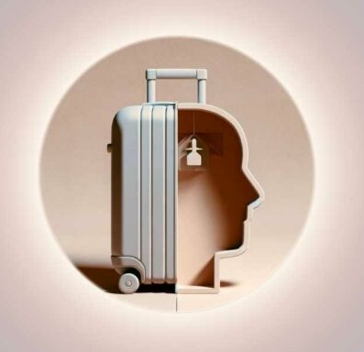
Excess Baggage

Slide 6

Who suffers the most?

Slide 7


Slide 8
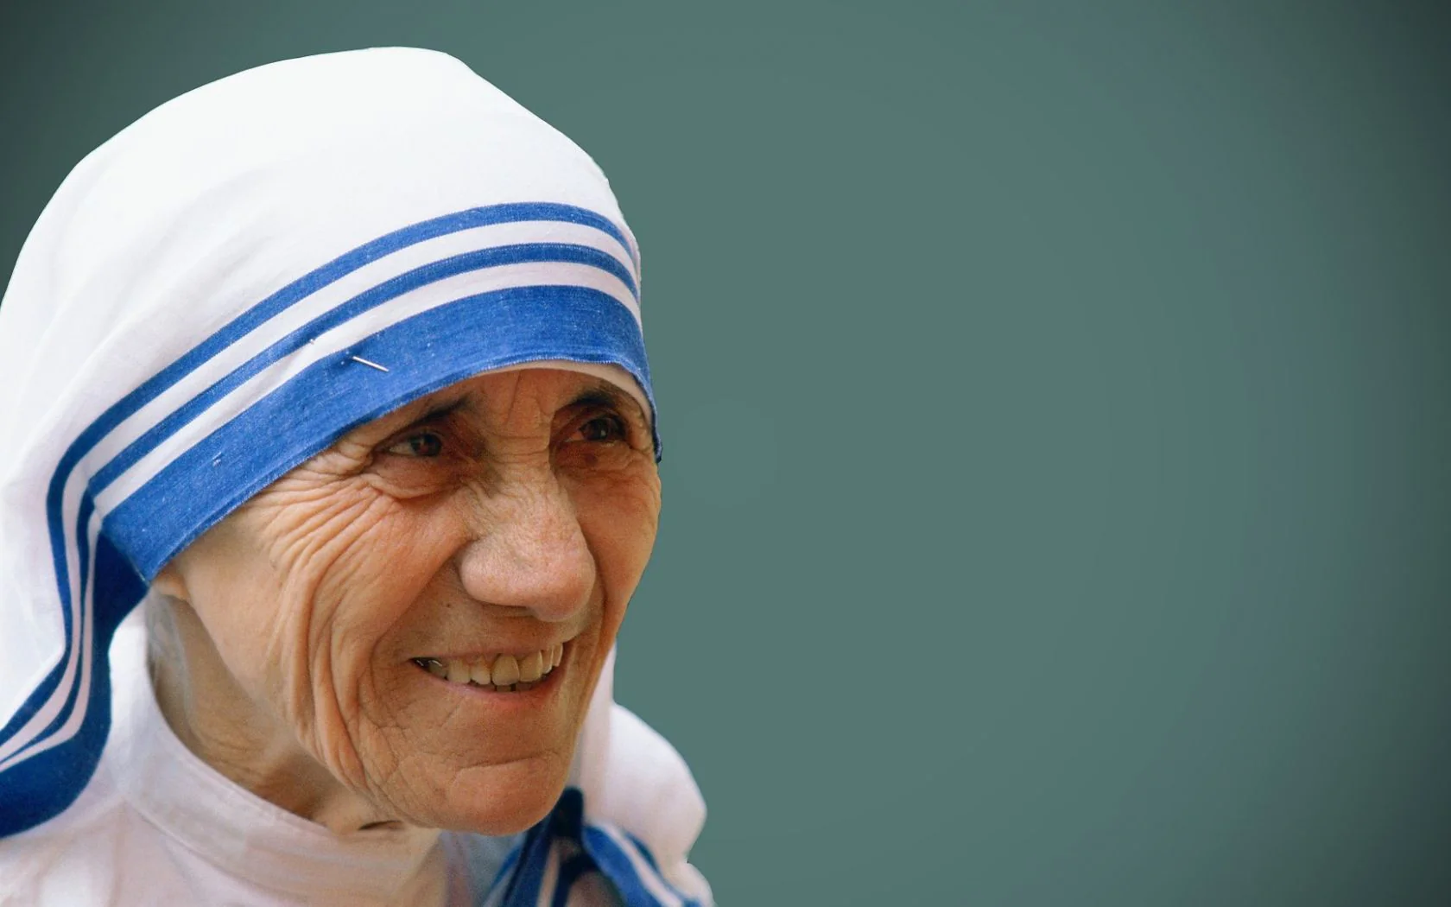
“You want to change the world, go home and love your family.”
^{St. Theresa of Kolkata}

Slide 9

Journey
With-in

Slide 10


Slide 11

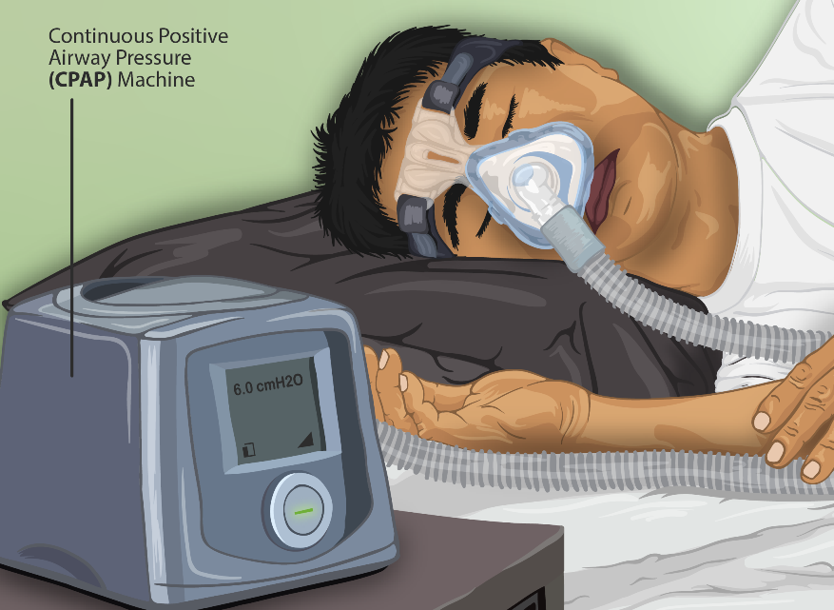

Slide 12



Slide 13

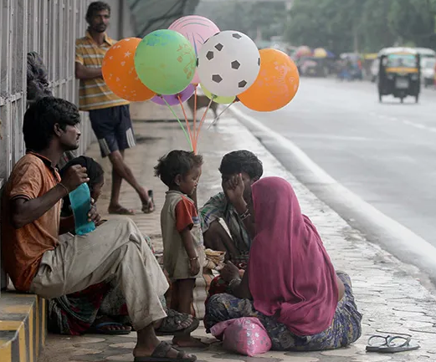

Slide 14




Slide 15
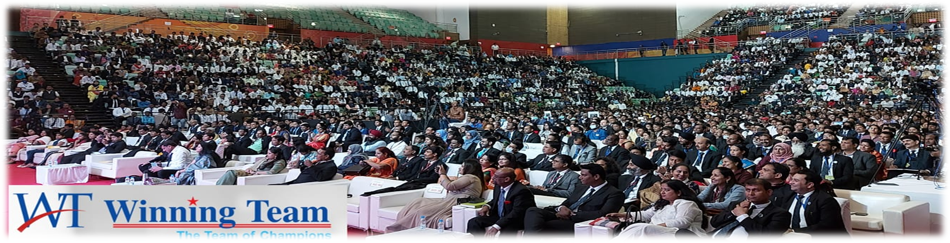


Slide 16



Slide 17


Slide 18



Slide 19

Warm
heart
Cool
mind

Slide 20



Slide 21


